Slide 1
Chapter 20
Process-Oriented
Methodologies

Slide 2
STRADIS
Initial study
Detailed study
Defining and designing alternative solutions
Physical design

Slide 3
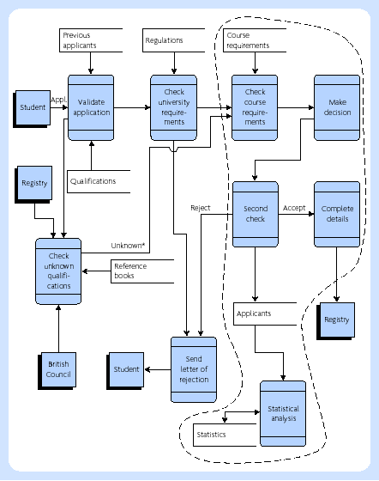
Example of a system boundary (dashed line) on a DFD

Slide 4
Detailed study
A definition of the user community for a new system, that is, the names and responsibilities of senior executives, the functions of affected departments, the relationships among affected departments, the descriptions of clerical jobs that will be affected, and the number of people in each clerical job, hiring rates, and natural attrition rates
A logical model of the current system, that is, an overall data flow diagram, the interfacing systems (if relevant), a detailed data flow diagram for each important process, the logic specification for each basic process at an appropriate level of detail, and the data definitions at an appropriate level of detail
A statement of increased revenue/avoidable cost/improved service that could be provided by an improved system, including the assumptions, the present and projected volumes of transactions and quantities of stored data, and the financial estimates of benefits where possible
An account of competitive/statutory pressures (if any) including the system cost and a firm cost/time budget for the next phase (defining a menu of possible alternatives)

Slide 5
STRADIS: Stage 3 report
A DFD of the current system
The limitations of the current system, including the cost and benefit estimates
The logical DFD of the new system
For each of the identified alternatives, the design will include
statements covering:
The parts of the DFD that would be implemented
The user interface (terminals, reports, query facilities, and so on)
The estimated costs and benefits
The outline implementation schedule
The risks involved

Slide 6
STRADIS: Physical design
The professional time and computer test time required to develop the identified modules
The computer system required
The peripherals and data communication costs
The professional time required to develop user documentation and train users
The time of the users who interact with the system
The professional time required to maintain and enhance the system during its lifetime

Slide 7
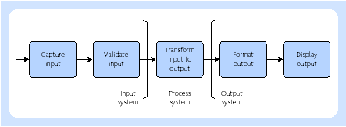
STRADIS: transform-centred system

Slide 8
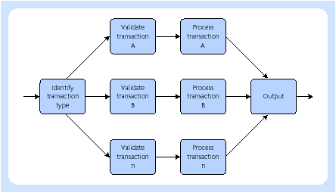
STRADIS: transaction-centred system

Slide 9
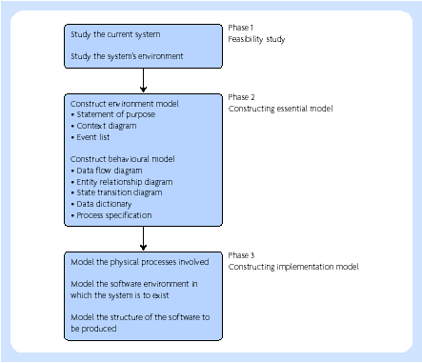
Yourdon Systems Method (YSM)

Slide 10
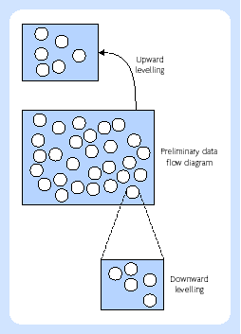
Upward and downward levelling of YSM DFD

Slide 11
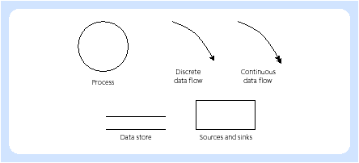
YSM DFD symbols

Slide 12
Jackson systems development (JSD)
Modelling phase
1. Entity action step
2. Entity structure step
Network phase
3. Initial model step
4. Function step
5. System timing step
Implementation phase
6. Physical system specification step

Slide 13
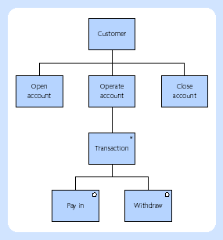
JSD structure diagram

Slide 14
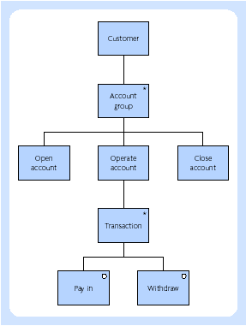
JSD structure diagram – customer with more than one account

Slide 15
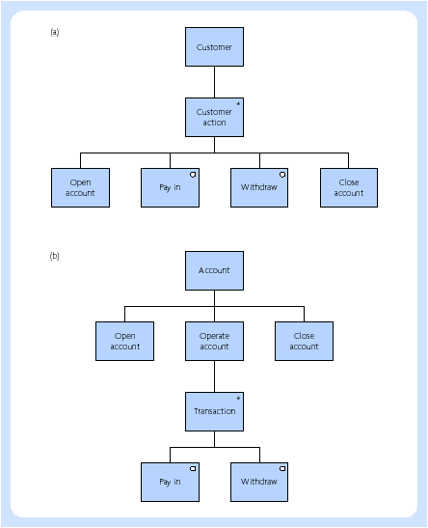
JSD structure diagram – simultaneous operation of many accounts

Slide 16
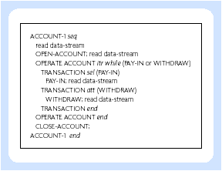
JSD structure text

Slide 17
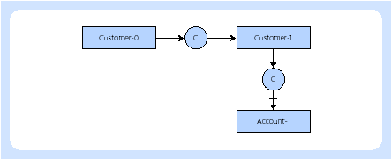
JSD system specification diagram

Slide 18
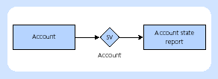
State vector connection between processes

Slide 19
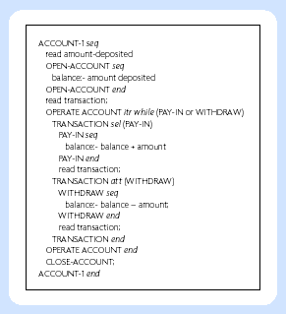
Addition of functions to structure text

Slide 20
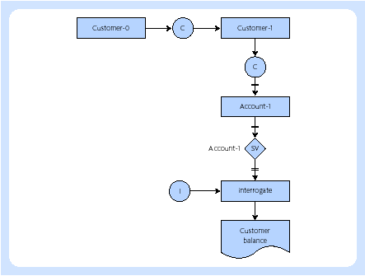
System specification diagram with interrogation process

Slide 21
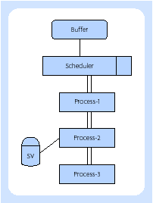
System implementation diagram

